Slide 1
Software Requirement Engineering
Introduction
Dr. Muhammad Nasir
m.nasir@iiu.edu.pk
Scientists study the world as it is, engineers create the world that never has been.”
–Theodore von Kármán (1881-1963)

Slide 2
Agenda
Understanding Requirements
Terms and Definitions
Types of Requirements
Requirement Engineering Activities

Slide 3
Understanding Requirement
Understanding the requirements of a problem is among the most difficult tasks that a software engineer face
When you first think about it, developing a clear understanding of requirements doesn’t seem that Difficult.
After all, doesn’t the customer know what is required?
Surprisingly, in many instances the answer to this question is “No.”

Slide 4
Understanding Requirements
It’s your worst nightmare when a customer walks into your office, sits down, looks you straight in the eye, and says,
“I know, you think, you understand, what I said… but what you don’t understand, is, what I said, is not, what I meant.”
This happens often late in the project, after deadline commitments have been made, reputations are on the line, and serious money is at stake.

Slide 5
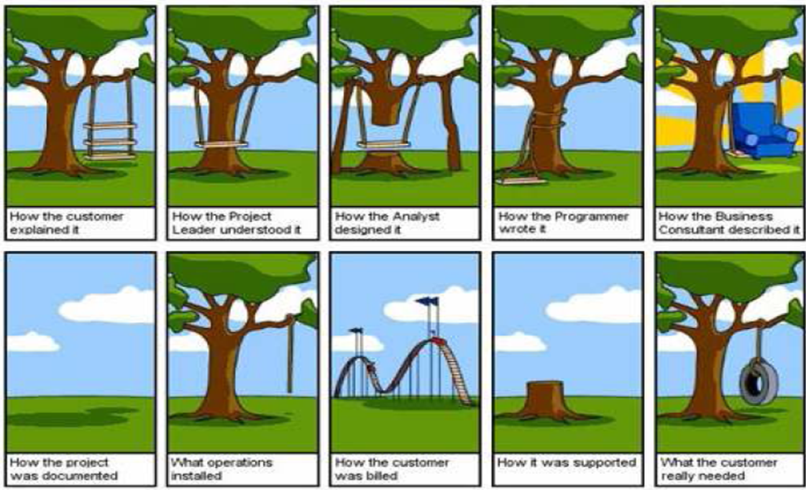
Famous Requirement Story

Slide 6
Customer Myth About Requirement Change
Myth: Project requirements continually change, but change can be easily accommodated because software is flexible.
Reality: Customer can review requirements and recommend modifications with relatively little impact on cost.
When changes are requested during software design, the cost impact grows rapidly. Below mentioned figure for reference.

Slide 7
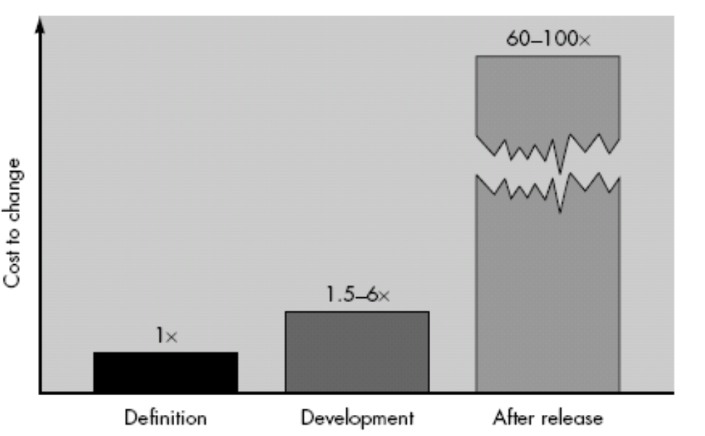
Cost of Change in Software Development Life Cycle

Slide 8
Requirement Engineering
“…the process of discovering the
requirements for a system by communication
with customers, system users and other who
have a stake in the system development.”
(Ian Sommerville)
“...the process of discovering the
requirements for a system by communication
with stakeholders and through the
observation of them in their domain”
(Tony Gorschek)
Notes:
1. A design engineer is a person who may be involved in any of various engineering disciplines including civil, mechanical, electrical, chemical, textiles, aerospace, nuclear, manufacturing, systems, and structural /building/architectural. Design engineers tend to work on products and systems that involve adapting and using complex scientific and mathematical techniques. The emphasis tends to be on utilizing engineering physics and sciences to develop solutions for society.
2. Manufacturing Engineering is a branch of professional engineering. Manufacturing engineering requires the ability to plan the practices of manufacturing; to research and to develop tools, processes, machines and equipment; and to integrate the facilities and systems for producing quality products with the optimum expenditure of capital.^{[1]}
The manufacturing or production engineer's primary focus is to turn raw material into an updated or new product in the most effective, efficient & economic way possible.

Slide 9
What is Requirement?
A software capability needed by the user to solve a problem to achieve an objective (Darfman and Thayer)
  OR
A software capability that must be met or possessed by a system or system component to satisfy a contract, standard, specification.
Notes:
Science: “The intellectual and practical activity encompassing the systematic study of the structure and behavior of the physical and natural world through observation and experiment”
Engineering is the application of Scientific, Economic, Social, and Practical knowledge in order to design, build, and maintain structures, machines, devices, systems, materials and processes.

Slide 10
Types of Requirements
Functional Requirements
Non-Functional Requirements (Quality Requirements)
What is Quality?
    Ability to satisfy stated or implied needs.

Slide 11
Functional vs. Quality Requirements
Functional requirements describe what a system will do.
  Impact on algorithms
  Impact on software execution
Quality requirements describe how the system will do it.
  Sometimes impact on implementation (e.g., performance)
  Impact on software structure = software architecture

Slide 12
Types of Requirements
Source of Requirements:
  Customer-driven
    involve a specific customer who needs a system to solve a specific problem
    One-off (‘bespoke’)
  Market-driven
    involve a developer who needs to develop a system to be sold in the market
  Hybrid
    developed for a specific customer, but want to market the software eventually
  Internal or In-house
    Some employees of a company needs a system to solve a specific problem.
    The system is developed by the employees of the same company.
    May or may not involve consultant(s)
New system vs. Upgrade to existing system

Slide 13
Systems’ Four Worlds View
Subject World
  the subject matter of the system: e.g., Business Market, Cricket Match
Development World
  the development process, team, schedule, required qualities (security, performance,…) etc.
System World
  what the system does within its operational environment, what information it contains and what functions it performs;
Usage World
  the environment within which the planned system will operate, e.g., Stock Market,

Slide 14






Systems’ Four Worlds View
needs Information about
maintains Information about
Subject World
Uses
Usage World
System World
Contracts
Builds
Development World

Slide 15
Process
“A process is an organized set of activities which transforms inputs to outputs”
Process descriptions encapsulate knowledge and allow it to be reused
Examples of design processes
  Designing a processor chip
  Requirement's engineering

Slide 16
Requirement Engineering
Requirement Engineering provides the appropriate mechanism for understanding
what the customer wants, analyzing need, assessing feasibility, negotiating a reasonable solution, specifying the solution unambiguously, validating the specification and managing the requirements as they are transformed into an operational system

Slide 17
Requirements Engineering Process Activities
Inception —Establish a basic understanding of the problem and the nature of the solution.
Elicitation —Draw out the requirements from stakeholders.
Elaboration (Highly structured)—Create an analysis model that represents information, functional, and behavioral aspects of the requirements.
Negotiation—Agree on a deliverable system that is realistic for developers and customers.
Specification—Describe the requirements formally or informally.
Validation —Review the requirement specification for errors, ambiguities, omissions, and conflicts.
Requirements Management —Manage changing requirements.

Slide 18
The End
Thanks for listening
Questions would be appreciated.

